Slide 1
Intro to Async
GRDevDay, 2015
Notes:
This is a brand-new talk. Very flexible!
You drive! Ask questions!

Slide 2
Who is this guy?

Slide 3
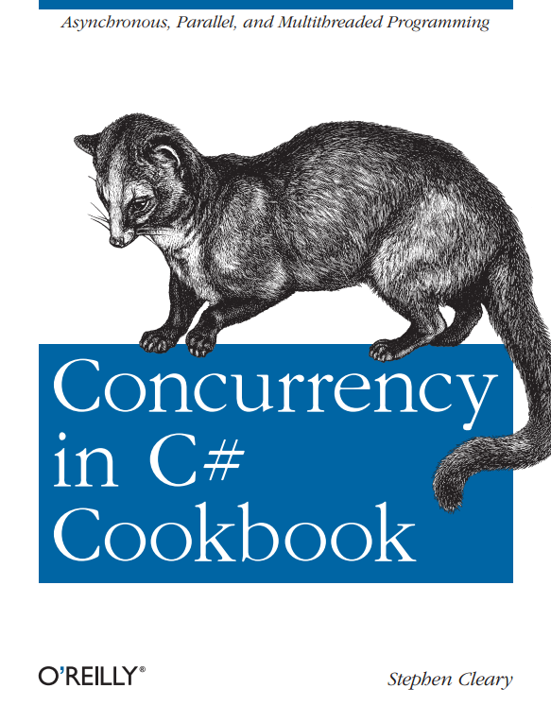

Slide 4
Async as a Technology
Notes:
How does async compare to multithreading, reactive extensions, etc?
When would I want to consider using async?

Slide 5
Terminology
Concurrent
Dataflow
Reactive
Multithreaded
Rx
Task.Run
Asynchronous
Parallel
Async/Await
PLINQ, Parallel
Notes:
This slide is mostly about terminology, and there’s no definite standard or consensus yet.
I prefer to use the term “concurrency” for multiple things happening at the same time (e.g., DB/UI, ASP.NET server requests).
Most people immediately think of multithreading.
Multithreading is one way to get concurrency; e.g., ASP.NET will handle multiple requests on different threads by default.
“Parallelism” is parallel processing, one type of multithreading. E.g., Parallel LINQ and the Parallel Task Library.
Most parallelism does the same calculation for many pieces of data.
Asynchrony is a way to get concurrency without multithreading. E.g., freeing up the calling thread instead of blocking it while an I/O operation is in progress.
Asynchrony is one form of Reactive programming. “Reactive” just means your app reacts to events.
There are modern libraries that help with each of these kinds of concurrency.
Thread is dead. So is BackgroundWorker.
Most quoted line from my book: “As soon as you type new Thread(), it’s over; your project already has legacy code.”

Slide 6
When to use Async?
I/O-bound, not CPU-bound.
Operations (begin/end), not streams (subscribe/react).
Return to context, e.g., displaying results.
These should never be necessary for modern code:
CoreDispatcher.RunAsync or RunIdleAsync
Dispatcher.Invoke, BeginInvoke, or InvokeAsync
Control.Invoke or BeginInvoke
Notes:
CPU-bound code should use Task.Run or TPL.
Stream-based code should use Reactive Extensions or TPL Dataflow.

Slide 7
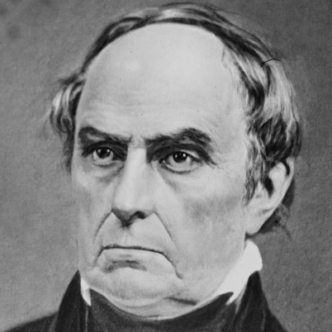
Asynchrony != Multithreading
“UNTHREAD’ING, ppr. Depriving of a thread.”
Webster’s Dictionary (1828)
Daniel WebsterD
Notes:
Asynchrony is a form of concurrency without using threads.
Multithreading/parallel code approach concurrency by using more threads.
Async code approaches concurrency by freeing up threads.
Async does not create new threads.

Slide 8
There Is No Thread
My code
Task
IOCP
BCL/library
OVERLAPPED
APC
OS
User mode
Kernel mode
IRP
DPC
Device driver
ISR
Notes:
This is the ideal I/O scenario for .NET I/O that uses the standard IOCP/OVERLAPPED system.
IRP = I/O Request Packet
ISR = Interrupt Service Request
DPC = Deferred Procedure Call
APC = Asynchronous Procedure Call
IOCP = I/O Completion Port

Slide 9
Benefits of Async
On the client, the primary benefit is responsiveness.
Keeping the UI thread free.
Most async/await resources assume client-side.
On the server, the primary benefit is scalability.
“10x to 100x” scalability improvement.
Handles bursting traffic.
Asynchrony drives the scalability of Node.js as well as ASP.NET.
Code maintainability
Notes:
On the Internet, most “async” resources assume a client-side application: Windows Store or Desktop.
Many developers aren’t aware that “async” is useful on the server side as well.
It is possible to write asynchronous code without async/await, but the new keywords drastically improve maintainability of the code.

Slide 10
Tasks

Slide 11
Tasks are Operations
Two types: Task, Task<T>
Operations have a distinct beginning and ending.
By the time you get a task, it’s already started.
Three end states:
Successful completion. Task<T> will have a result.
Faulted. Task/Task<T> will have an exception.
Canceled.
Notes:
Tasks are “promises”, a representation of some operation that will complete in the future.
Task is an operation without a result value. Task<T> has a result value of type T.
Tasks are not threads.

Slide 12
Task: The Great Confusion
Promise Tasks
Primarily used by Asynchronous code.
Represents an event or signal.
Delegate Tasks
Primarily used by Parallel code.
Has code (delegate) to run; is scheduled, etc.
Notes:
For TPL devs: Task (as used by the TPL) is completely different than Task (as used by async).
For newbie devs: Task has a lot of baggage from the TPL; most members should just not be used.
In particular, use await, not Wait or Result!

Slide 13
Demo: Thinking about Tasks
Delay and Download
Notes:
Two examples of threadless tasks.
What goes on under the covers?
Both tasks represent some operation that will complete in the future.
Both tasks have already started. Maybe already completed, too.

Slide 14
Async Syntax

Slide 15
Introduction to Async
async Task DoNothingAsync()
{
// In the Real World, we would actually do something...
await Task.Delay(100);
}
The async keyword:
Enables the await keyword for that method.
Transforms the method into a state machine, similar to the yield keyword.
That’s it!
Notes:
The async keyword can only be applied to a method.
Details of the transformation are not important; just be aware that there is a transformation going on.

Slide 16
Introduction to Async
async Task DoNothingAsync()
{
// In the Real World, we would actually do something...
await Task.Delay(100);
}
async Task DoNothingAsync()
{
Task delay = Task.Delay(100);
await delay;
}
await
Takes a single argument.
“Awaitable”
Usually a Task or Task<T>.
Notes:
“Await” is like a unary operator; it takes a single argument (like a cast).
This argument is an “awaitable”. I won’t get into the specifics, but an “awaitable” is a type that matches a certain pattern (similar to how foreach works).
An “awaitable” represents an asynchronous operation. In this talk, all our “awaitables” are Task objects.
Technically, you don’t “await” a method; you call the method and then “await” the Task it returns. But “await a method” and “awaitable method” are common phrases.
- Another method can await the task returned from DoNothingAsync, not b/c the method is async, but b/c it returns a Task.
Async methods start synchronously; so this method will (synchronously) call Task.Delay and then await.
Await is where things can start to get asynchronous.

Slide 17
Introduction to Async
async Task DoNothingAsync()
{
// In the Real World, we would actually do something...
await Task.Delay(100);
}
await behavior:
If awaitable (task) is complete, continues synchronously.
Otherwise:
Pauses the method and registers it with the awaitable.
Then returns.
Notes:
The “registering” is saying, “when you complete, please resume this method”.
When DoNothingAsync returns, it returns an incomplete Task.
This Task is completed when the DoNothingAsync completes (end of method or “return” statement).

Slide 18
Introduction to Async
async Task DoNothingAsync()
{
// In the Real World, we would actually do something...
await Task.Delay(100);
}
Pausing and Resuming (when awaiting tasks)
A “context” is captured and used to resume.
UI thread, ASP.NET request, thread pool.
Actually current SynchronizationContext or TaskScheduler.
Notes:
In ASP.NET the “context” is the request context (HttpContext.Current, identity, and culture).
In this example, if you have the request context before the await, then you’ll have it after the await.
Request context only allows one thread at a time.

Slide 19
Introduction to Async
The async keyword creates (and returns) a task for you.
What the task means:
Represents the execution of the method.
When the method completes, the task is completed.
Contains the result of the method (including exceptions).
Return statements complete the task (returned value becomes the task’s result).
Exceptions fault the task (captured and placed on the task).

Slide 20
Demo: Async Basics
Notes:
Returning values. Resuming in context.
Throwing exceptions.
Task exceptions are observed when await’ed.

Slide 21
Here be Dragons
Notes:
Before expanding our async knowledge, let’s review a couple of common pitfalls.

Slide 22

Async: Sharp Corners
Async methods that return void.
Blocking on Tasks.
Task.Wait
Task<T>.Result
Notes:
Void is a problem because the async method cannot return a task that represents the method.
Blocking is a problem because async methods cannot resume in a blocked context.

Slide 23

Async: Sharp Corners
Avoid async void.
Async all the way.
Notes:
Async void is allowed for event handlers, so don’t use it in your business logic.
Don’t block on async code.

Slide 24
Next Steps: More Concurrency

Slide 25
Asynchronous Concurrency
Save Tasks into variables, await them later.
Task.WhenAll
Works great with LINQ’s Select.
Notes:
Returns a task that completes when all argument tasks have completed.

Slide 26
Demo: More Concurrency
Notes:
Multiple Delays/Downloads.

Slide 27
Next Steps: Cancellation

Slide 28
Cancellation
CancellationTokenSource – controls a CancellationToken.
CancellationToken – used to detect cancellation.
ThrowIfCancellationRequested
Register(delegate)
Seldom used directly.
Notes:
Usually, just pass CancellationToken to next method in the chain.

Slide 29
Demo: Cancellation

Slide 30
Next Steps: Progress Reporting

Slide 31
Progress Reporting
IProgress<T> - a “sink” for progress updates.
Progress<T> - built-in implementation.
Others, too!
Your own. E.g., Rx for throttling UI updates.
Other libs. E.g., SignalR.
Notes:
Each progress update is of type T.
The built-in implementation is great for UI but isn’t intended to be used everywhere.

Slide 32
Demo: Progress Reporting

Slide 33
Play Well with Others
Follow the Task-based Asynchronous Pattern (TAP):
http://msdn.microsoft.com/en-us/library/hh873175.aspx
Async interaction with OOP (i.e., async constructors/properties/events/etc):
http://blog.stephencleary.com/2013/01/async-oop-0-introduction.html

Slide 34
Q&A
Go forth and be awesome!
Notes:
Resources are available at StephenCleary.com - slides, example code, etc.

